Slide 1
PERFECT COMPETITION
MGCR 293
Professors: Dr. K. Salmasi
Tariq Nizami
Taweewan Sidthidet
T.A.: Mike Brintnell
Presentation Credit: Brianna Mooney

Slide 2
CHAPTER REVIEW

Slide 3
PERFECT COMPETITION
Large number of firms
Standardized product
No barriers to entry
Price takers

Slide 4
MARKET POWER
Market power refers to the ability of a firm to influence/control the price they charge
Since firms have no ability to influence price (ie: no market power) in a perfectly competitive market, they produce at the profit-maximizing quantity with price as given
Since the price is given for an individual firm, the demand curve is perfectly elastic. In other words, the demand curve is horizontal
Notes:
The Demand curve is horizontal because the demand for a standardized product is perfectly elastic-they are price takers.

Slide 5
DEMAND AND MARGINAL REVENUE
Since price is constant, the additional revenue gained from one additional unit Q equals the price of that additional unit P
In other words, marginal revenue equals price in a perfectly competitive market
MR=P

Slide 6
PROFIT MAXIMIZATION
As usual, a firm will produce where MR=MC
Since P = MR, the profit maximizing output is where P=MC
https://www.youtube.com/watch?v=Z9e_7j9WzA0

Slide 7
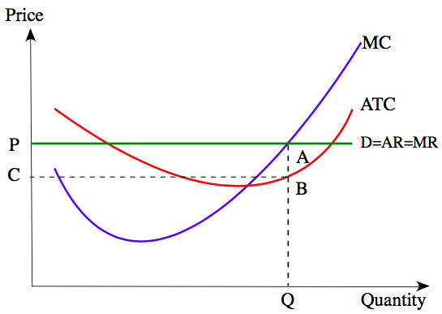
FOR AN INDIVIDUAL FIRM

Slide 8
SHORT RUN PROFIT AND LOSS
Economic profit when P>ATC
Economic loss when P<ATC
When to produce at a loss or shut down temporarily?

Slide 9
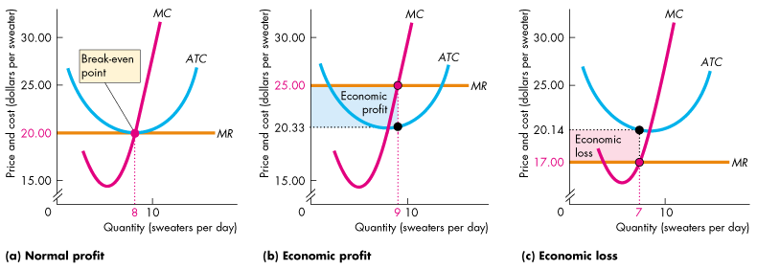
SHORT RUN PROFIT, LOSS AND BREAKEVEN
In the short run, firms can either earn a normal profit (ie: break-even), earn an economic profit or earn an economic loss

Slide 10
TEMPORARY SHUT-DOWN
If P < ATC, we must look at AVC to decide whether to continue producing
If P > AVC, producing at an economic loss will still cover a portion of total fixed costs, and the firm will lose less by continuing producing as compared to shutting down
If P < AVC, producing at an economic loss does not cover your variable or fixed costs, and the firm would lose less by shutting down as compared to continuing to produce

Slide 11
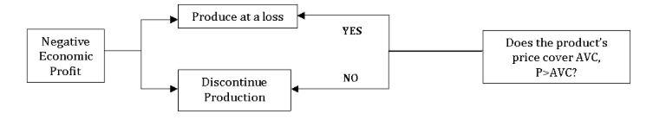
TEMPORARY SHUT-DOWN
If at the profit maximizing point (ie: MR = MC), P = AVC, the firm will shut down
Notes:
Rationale is that if you can cover all of your variable costs, you can still be more profitable than shutting down because you are at least covering a portion of your total fixed costs, whereas if you shut down, you are not covering any of your fixed costs
If you are producing at a point where your price does not even cover your variable costs, there is no point in continuing production and having to pay both fixed costs and additional variable costs out of pocket.

Slide 12
PRODUCER SURPLUS
Producer surplus is the difference between what a producer would have been willing to sell a good or service for and the price (ie: equilibrium price) received for a good or service
It is represented as the area beneath equilibrium price and above the supply curve.
Represents a social benefit for producers

Slide 13
LONG RUN EQUILIBIRUM
In the long-run, no firm can earn an economic profit or loss due to firms’ free entry and exit
If a firm makes an economic profit, other profit seeking firms will enter the market, increasing the market supply, and lowering the equilibrium price to equal LRAC at the profit maximizing quantity (MR = LRMC)
If firm a makes an economic loss, firms will leave the market, reducing the market supply, and therefore causing the equilibrium price to increase
Firm entry and exit will stop when P = LRAC (ie: economic profit is 0)

Slide 14
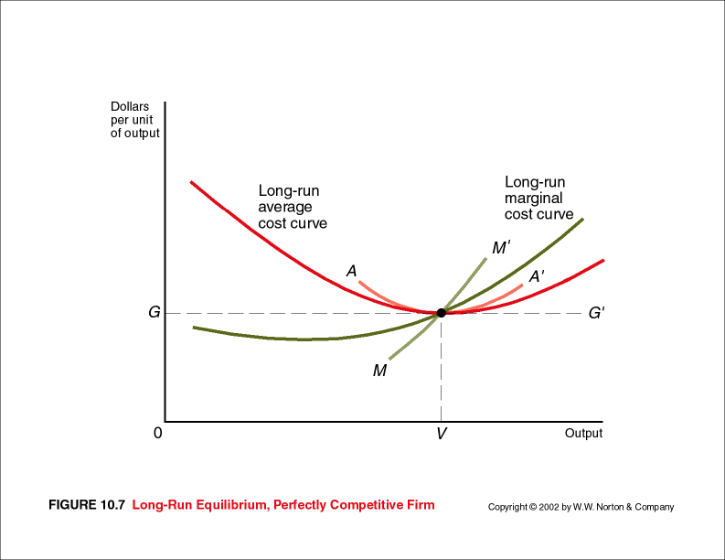
LONG RUN EQUILIBRIUM
At profit maximization in LR, MR = P = LRMC = min. LRAC
This implies no economic profit

Slide 15
CHAPTER QUESTIONS

Slide 16
QUESTION 1
The Hamilton Company is a member of a perfectly competitive industry, its total cost function is
TC=25,000 +150Q +3Q²
Where TC is the firm’s monthly total cost and Q is the firms output.
If the industry is in long-run equilibrium, what is the price of the Hamilton Company’s Product?
What is the firm’s monthly output?

Slide 17
SOLUTION
In LR equilibrium, MC=AC:
MC=150 + 6Q, AC= (25000/Q) +150 + 3Q
150+6Q = (25000/Q) +150 + 3Q
Q = 91.3
Since MR = MC at profit maximization,
P=MC and thus P= 150 + 6(91.3) = $697.7
b) 91.3 units

Slide 18
QUESTION 2
The box industry is perfectly competitive. The lowest point on the long- run average cost curve of each of the identical box producers was $4. The minimum point occurred at an output of 1,000 boxes per month. The market demand curve for boxes was:
Q_{D}=140,000 – 10,000P
Where P was the price of a box (in dollars per box) and Qd was the quantity demanded per month. The market supply curve for boxes was:
Q_{S}=80,000 + 5,000P
Where Qs was the quantity supplied per month.

Slide 19
QUESTION 2
What was the equilibrium price of a box? Is this the long-run equilibrium price?
How many firms are in this industry when it is in the long-run equilibrium?

Slide 20
SOLUTION
a) Qd=Qs:
140,000 – 10,000P = 80,000 + 5,000
P=$4
Therefore since P = AC = $4, this is the long run equilibrium price
b) Qd = 140,000 – 10,000(4) = 100,000 units
Qs = 80,000 + 5,000(4) = 100,000 units
Therefore equilibrium market quantity is 100,000 units
Each firm can produce 1,000 units
Therefore 100,000/1,000 = 100 firms

Slide 21
QUESTION 3
The Burr Corporation’s total cost function:
TC=200 +4Q +2Q²
If the firm is perfectly competitive and the price of its product is $24, what is its optimal output?
At this output rate, what is its profit?

Slide 22
SOLUTION
a)We know optimal output means MR = MC. Since in perfect competition MR = P we can write
24 = 4 +4Q → Q=5
Optimal output is 5
b)Profit=TR-TC
Profit = 24(5) - (200+4(5)+2(5)²)= -$150
The firm loses $150 but this is less than if they chose to shutdown (would lose $200 fixed cost)
Notes:
If you were to take the AVC from the TC equation AVC= 4+2Q
At output 5, AVC= 4+10 = 14
Since 24>14, they should operate at a loss

Slide 23
QUESTION 4
The supply and demand curves for pears are
Q_{S} = 10,000P
Q_{D} = 25,000 – 15,000P
a) What is the equilibrium price?
b) What is the equilibrium quantity?

Slide 24
SOLUTION
a) 10,000P = 25,000 - 15,00P
P=1
b) Qs = 10,000(1)
Q=10,000

Slide 25
QUESTION 5
The lamp industry is perfectly competitive. The price of a lamp is $50, the firm’s total cost function is
TC=1000 +20Q +5Q²
What output maximizes profit?
What is the firm’s economic profit at this output?
What is the firm’s average cost at this output?
If other firms in the lamp industry have the same cost function as this firm, is the industry in equilibrium?

Slide 26
SOLUTION
a) P=MC (profit-maximizing output)
50=20+10Q
Q=3
We need to ensure that the P > AVC at this output.
TVC = 20Q + 5Q² → AVC = 20 + 5Q
At an output of Q =3, AVC = 20 + 5(3) = $35. Therefore $50>$35.
b) Profit = TR – TC = PQ – TC
= 50(3) - (1000+20(3)+5(3²)
=150 – 1105=-955
The profit is -$955

Slide 27
SOLUTION
b) Profit = TR – TC = PQ – TC
= 50(3) - (1000+20(3)+5(3²)
=150 – 1105=-955
The profit is -$955

Slide 28
SOLUTION
c) ATC=(1000/Q)+20 +5Q
=(1000/3)+20 +5(3)
=368.33
The average total cost is $368.33
d) The industry is not in equilibrium, since MC and P do not equal ATC. More simply, the firms are earning an economic loss. In the long run, some firms will leave the industry, leaving the remaining firms with long run average cost equal to long run marginal cost

Slide 29
QUESTION 6
The long-run supply curve for a
particular type of kitchen knife is
horizontal line at a price of $3 per
knife. The demand curve for such a
kitchen knife is Q =50 – 2P

Slide 30
QUESTION 6
What is the equilibrium output of such knives?
b) If the tax of $1 is imposed on each knife, what is the equilibrium output of such knives? (Assume the tax is collected by the government from the supplier of knives).
c)After the tax is imposed you buy such a knife for $3.75. Is this the long-run equilibrium price?

Slide 31
SOLUTION
a) In equilibrium, Pd = Ps. Since Ps = $3,
Qd = 50 – 2(3) = 44 units
b) P is now $4
Qd = 50 – 2(4) = 42 units
c) No. The price must be $4 in the long-run equilibrium. Firms would be incurring losses if the price were $3.75 as the $1 tax is deducted from this value which would leave the firm with $2.75 which is less than the $3 cost. Firms would exit the industry, reducing the supply and therefore increasing the price to $4 such that no economic profit is made.

